Slide 1
Happiness consists in getting enough sleep. Just that, nothing more.” ― Robert A. Heinlein,

Slide 2

I want to be happy, i want to be this happy !

Slide 3
Why is sleep so important
Lack of sleep can make you gain weight !
Sleep can improve your concentration and productivity
Sleep strengthen your heart and affect your metabolism in a crucial way
Poor Sleep is linked to DEPRESSION !

Slide 4
Do I get enough sleep ? Am I going to be happy ? 🤔

Slide 5
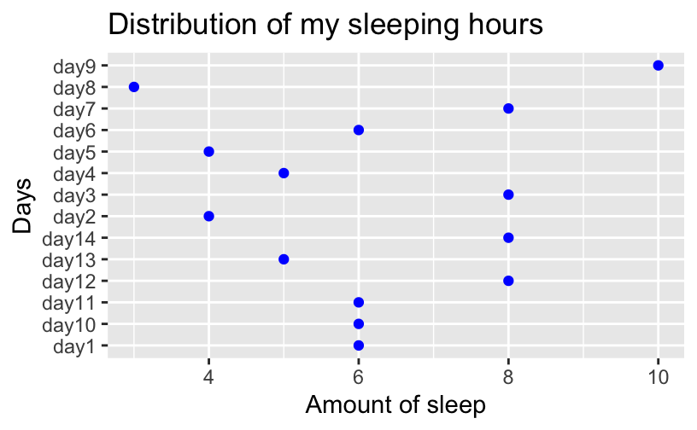

Slide 6
According to the National Sleep Foundation the recommended amount of sleep is 8 hours for adults, is my average amount of sleep less or greater than this amount ?

Slide 7
MY HYPOTHESIS
H0: The average of my amount of sleep is equal to the average of 8 hours recommended by the National Sleep Foundation
Ha: the average of my amount of sleep is less than the average of 8 hours, recommended by the National Sleep Foundation

Slide 8

Bad news for me
Using the one sample t-test in R I got a p-value of 0.002
My p-value is less than the 0.05 significance level
From that I can came up with the conclusion that my null hypothesis is rejected. In fact, unfortunately, the average of my amount of sleep is less than the average of 8 hours

Slide 9
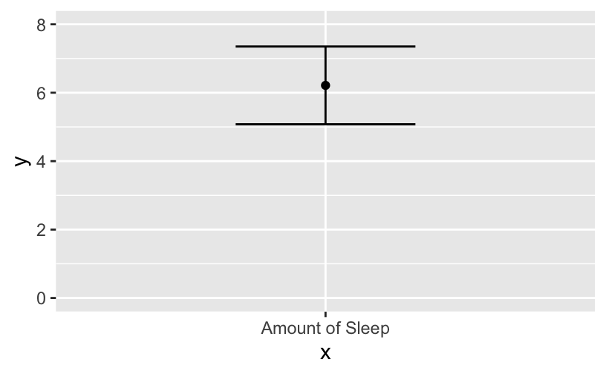
Error bar

Slide 10

Based on the graph, the error bar did not reach 8
We can conclude that my average amount of sleep is significantly less than 8 hours, that explain the crabbiness and the mood swing I go through some times !

